Slide 1
Using efficient methods
DEVELEOP JAVA PROGRAM FOR
CARRYING OUT THE FOLLOWING OPERATIONS 1) MATRIX MULTIPLICATION 2) PARTIONING OF MATRICES 3) EVALUATION OF DETERMINENT OF SQUARE MATRIX 4) INVERSE OF SQUATRE MATRIX 5) RANK OF A MATRIX 6) SOLUTION OF LINEAR EQUATIONS
WITH APROPRIATE DATA VALIDATION AND GUI MODULE. ALSO INCORPORATE SUITABLE COMMENTS TO MAKE THE PROGRAM MORE READABLE
Matrices
GUI
JFrame
JTextArea
JComboBox
JButton
JScrollPane
JOptionPane
Action Listener
Treating Matrices as a separate object and calling it whenever required.
Proposed Solution:
Creating a separate class of matrix (class Matrix)
It will contain all the required tasks as particular function for eg. RowInput , CollInput , RowCall, CollCall etc
Implements OOP along with keeping the code simpler to understand and easier to maintain and manipulate.
Using Gaussian-Elimination Method for finding Inverse
Custom Partitioning of Matrice as per the users choice
Rank
GROUP 3
MEMBER | ROLL.NO
HITESH BHATIA | 2301012
RHYTHM JAIN | 2301046
VINIT LUNIA | 2301063
SWAYAM MAHESHWARI | 2301065

Slide 2
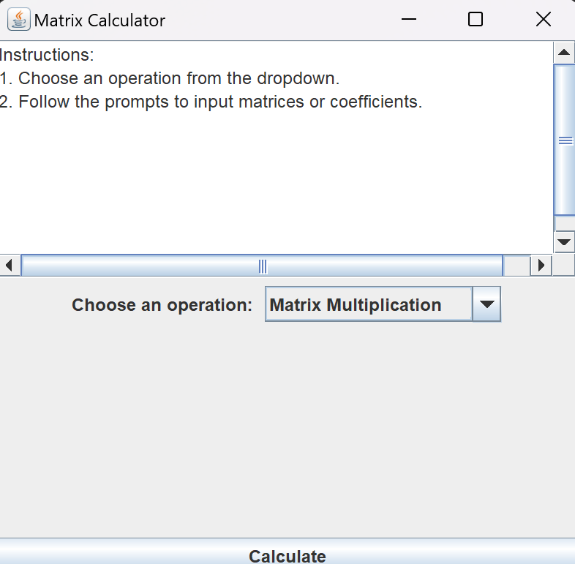
GUI
Using efficient methods
Matrices
GUI
USER-FRIENDLY DESIGN
INTERACTIVE ELEMENTS
ERROR HANDLING
PROPER MESSAGE DISPLAY
INPUT AND OPERATION BUTTONS
JFrame
JTextArea
JComboBox
JButton
JScrollPane
JOptionPane
Action Listener
Treating Matrices as a separate object and calling it whenever required.
Proposed Solution:
Creating a separate class of matrix (class Matrix)
It will contain all the required tasks as particular function for eg. RowInput , CollInput , RowCall, CollCall etc
Implements OOP along with keeping the code simpler to understand and easier to maintain and manipulate.
Using Gaussian-Elimination Method for finding Inverse
Custom Partitioning of Matrice as per the users choice
Rank

Slide 3
References
GUI
User and Code Flow
BroCode YouTube: https://www.youtube.com/watch?v=Kmgo00avvEw
GitHub Repositories: https://github.com/itsvinitlunia/MPR_Matrix
StackOverflow: https://stackoverflow.com/
USER-FRIENDLY DESIGN
INTERACTIVE ELEMENTS
ERROR HANDLING
PROPER MESSAGE DISPLAY
INPUT AND OPERATION BUTTONS
Window Initialization
Operation Selection
Action Handling (calling the actionPerformed( ) function)
Matrix Input
Display or Error Handling

Slide 4
References
User and Code Flow
Window Initialization
Operation Selection
Action Handling (calling the actionPerformed( ) function)
Matrix Input
Display or Error Handling
BroCode YouTube: https://www.youtube.com/watch?v=Kmgo00avvEw
GitHub Repositories: https://github.com/itsvinitlunia/MPR_Matrix
StackOverflow: https://stackoverflow.com/
THANK
YOU

Slide 5
THANK
YOU

